Slide 1


Slide 2

Christopher Shannon
Brian Del Carpio
Ian Wu
Simon Fraser University
CMPT 276

Slide 3
PROJECT OVERVIEW
Objective:
- Save users time when scheduling workouts
- Give users consistency so they can see their daily activities from one app
- Deliver an application to streamline the process of tracking workout schedules
- Bridge between Strava and Google Calendar
Technologies and Process:
- JavaScript/React, HTML, CSS
- Agile Kanban SDLC

Slide 4

CI/CD
CI:
- Regular code commits
- Tried using Docker for testing
- Kanban
CD:
- Assigning code reviewers
- Website testing
Benefits:
- Reduced risk of bugs deployed
- Avoiding stale Pull Requests

Slide 5

GOOGLE CALENDAR API
1) Create Events in google calendar
2) Recall past Events
3) Store events title, date, time and description

Slide 6

STRAVA API
1) Creating workouts
2) Displaying the workouts
3) Store the events, date, time and descriptions

Slide 7
PROJECT FEATURES
Plan Future Workouts:
- user inputs date and time
- uploads to google calendar
See Upcoming Workouts:
- user receive dates and times of upcoming workouts
Input Workouts:
- user inputs distance and duration of workouts
- uploads to Strava
Recall Past Workouts:
- user receives list of past workouts date and times

Slide 8

API Integration Complexities:
- Individual integrations were not straightforward
- Combining integrations required detailed technical understanding
Cross-Platform Compatibility:
- Significant challenges to maintain functionality and appearance
consistent
Performance Optimization:
- Quick loading times and smooth performance
User Data Security:
- Implementing extensive measures to protect sensitive data
Compliance and Legal Considerations:
- Addressing legal and compliance aspects
- User data, Third party API usage
Challenges

Slide 9

Scope of project too large
intermediate skill level
time constraints
Stricter Use of Kanban
clearer expectation of what needs to be done
Structured Communication is key
good to make expectation of when and where
small and frequent > big and spontaneous
Frequent commits often
better collaboration as you can work off each other
Adaptability
added database mid project
Project Takeaways
Notes:
key points structured communication

Slide 10
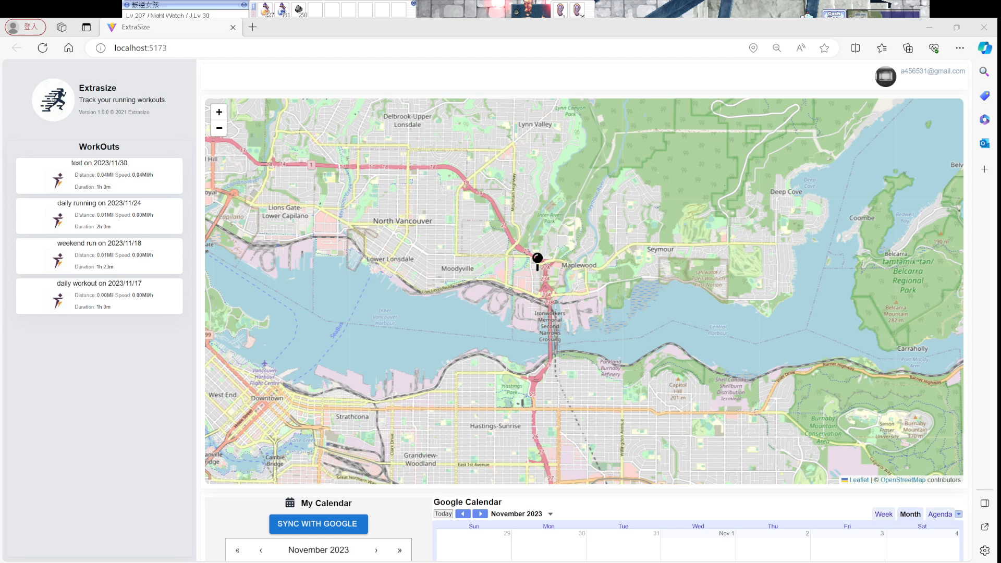
Video Demonstration
Youtube link

Slide 11
Thank you!

